Slide 2
Objectives
Have a closer look into the midlatitude cyclone formation we briefly addressed in Module 9
Clearly important as these are major storms systems in the continental U.S.
How do they form? Cyclogenesis
The concept of vorticity
Upper troposphere ridges and troughs / midlatitude cyclones

Slide 3
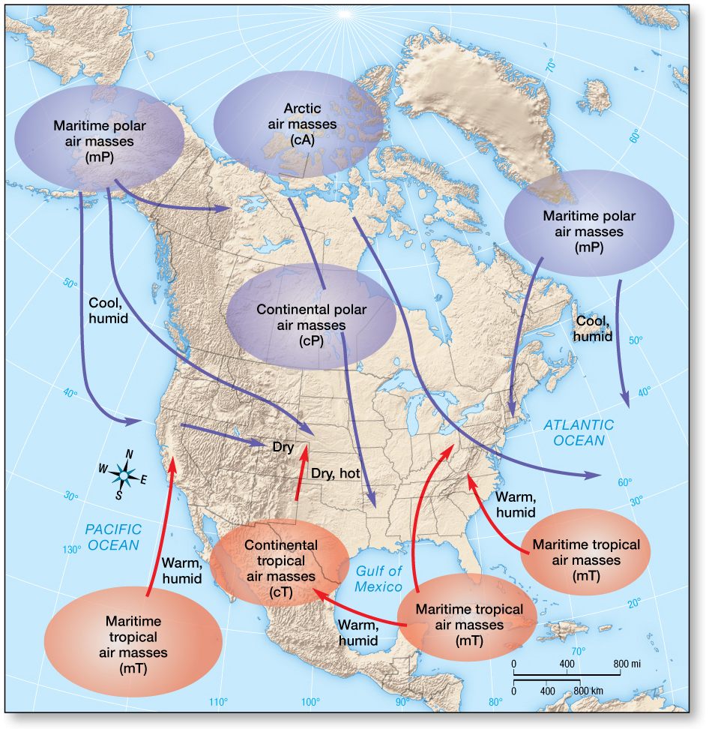
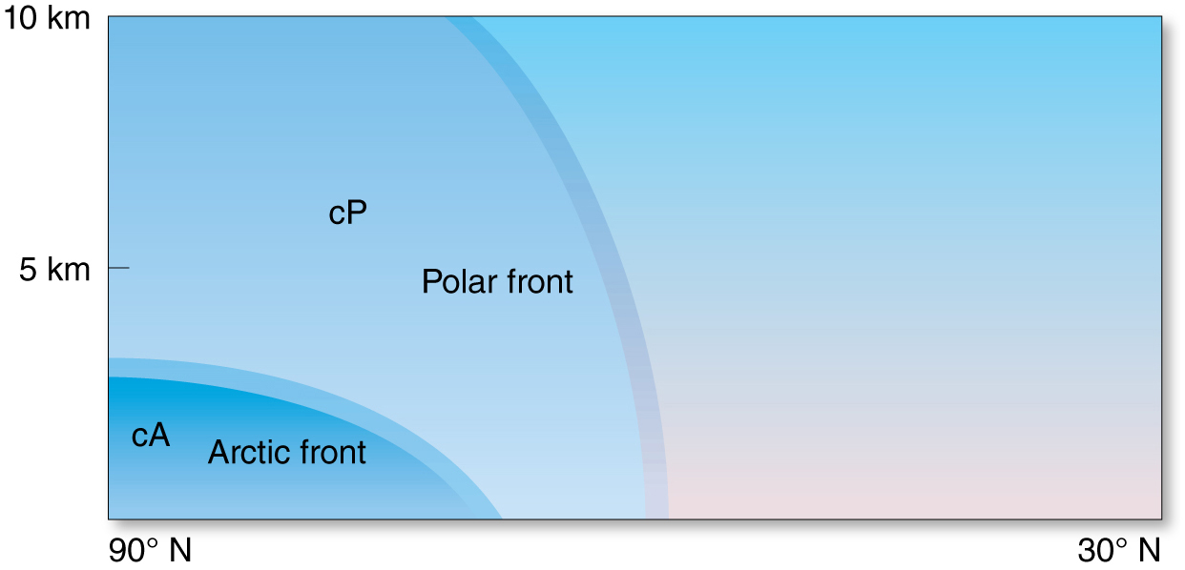
Polar Front Theory
Polar front theory describes interactions between unlike air masses and the related aspects of the midlatitude cyclone.
Midlatitude cyclones bring abrupt changes in wind, temperature, and sky conditions.
From Module 9, make the connection here to midlatitude cyclones

Slide 4
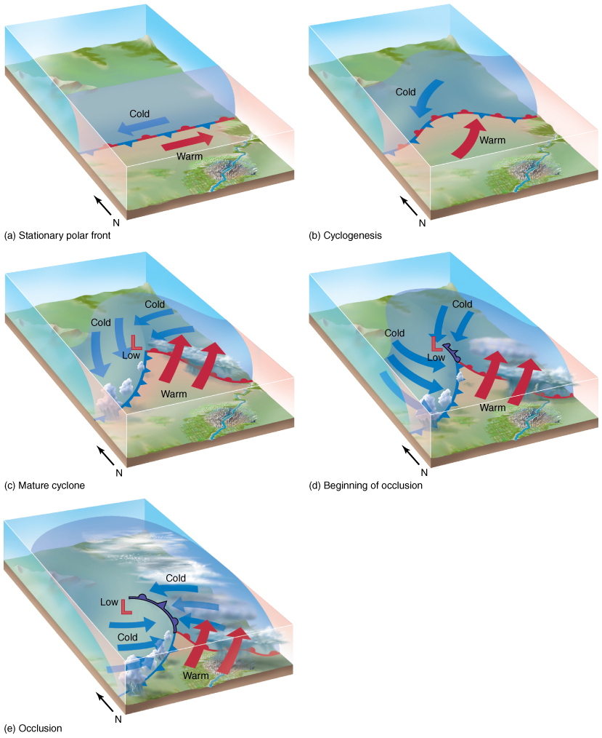
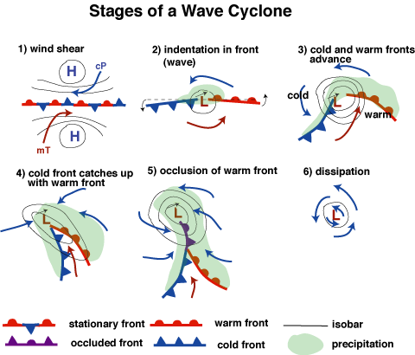
The Life Cycle of a Midlatitude Cyclone
from Module 9
Key point is the “cyclogenesis” (b), (2)
This is the formation of a midlatitude cyclone out of a stationary front, starting from a minor “kink” in the front

Slide 5
The Life Cycle of a Midlatitude Cyclone
Cyclogenesis
Cyclogenesis describes the formation of a midlatitude cyclone.
Occurs along the boundary separating cold easterlies from warmer westerlies.
A low pressure area forms and due to the counterclockwise flow colder air migrates behind a developing cold front.
Warmer air moves along a developing warm front (east of the system).
Clouds and precipitation occur with converging winds of the low pressure center and along the developing fronts.

Slide 6
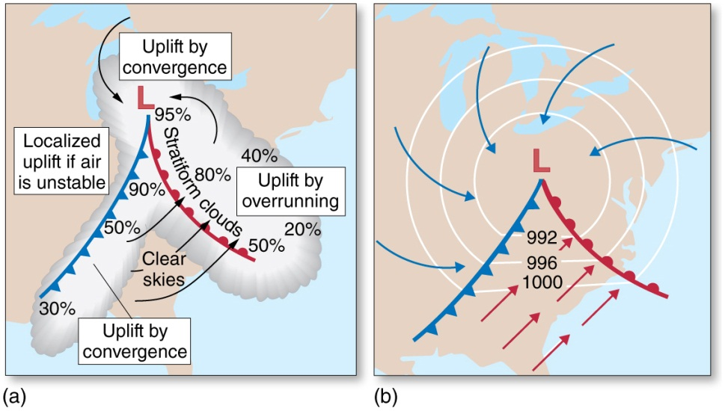
The Life Cycle of a Midlatitude Cyclone
Mature Cyclones
May produce heavy precipitation and severe thunderstorms associated with squall lines.
The system is capable of creating snow, sleet, freezing rain, and/or hail.
Winds, spiraling counterclockwise toward the low, change accordingly as the system, and its associated fronts, moves over particular regions.

Slide 7
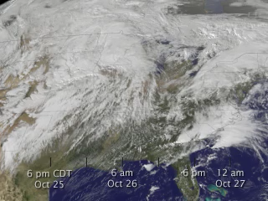
The Life Cycle of a Midlatitude Cyclone
If video doesn’t work:
https://clemson.instructure.com/courses/92136/files/folder/Lecture%20Slides/Module10_videos
Or go to Canvas: Files -> Lecture Slides -> Module10_videos
Movement of Cyclones
Develops as a weak disturbance
Progression of weather conditions over time for affected locations
General eastward migration, with northward or southward component (cold fronts move faster than warm fronts)

Slide 8
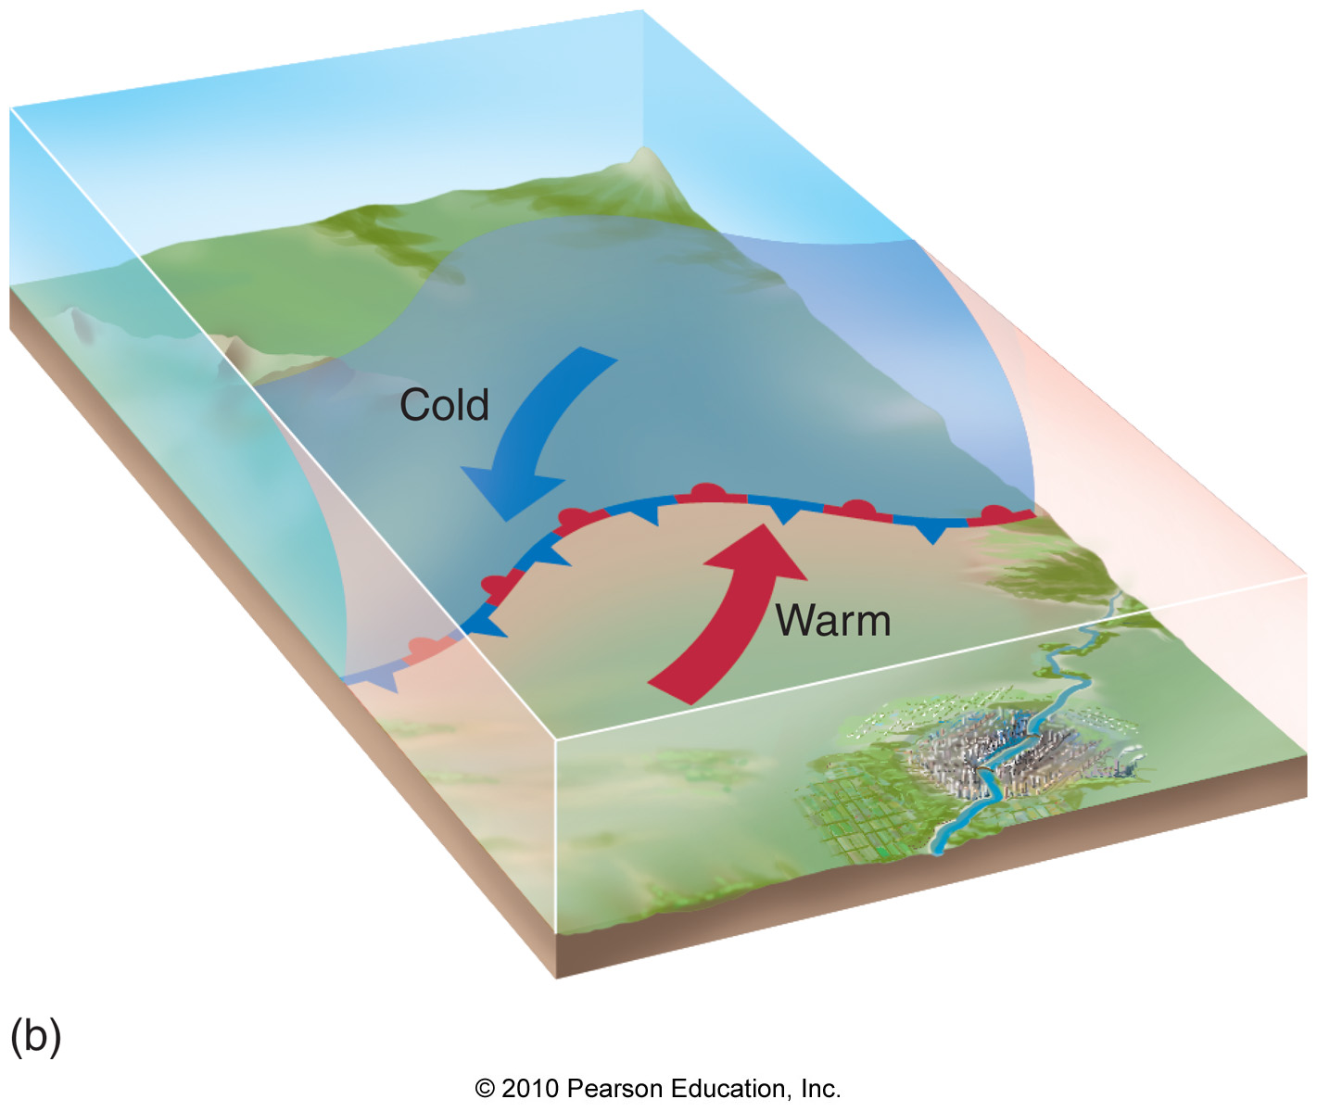
The Life Cycle of a Midlatitude Cyclone
Occlusion
Occlusion occurs when the cold front joins the warm front, closing off the warm sector.
Surface temperature differences are minimized.
The end of the cyclone’s life cycle.
Big question: How and why does the initial “kink” (sometimes called a minor disturbance) happen?

Slide 9
Processes of the Middle and Upper Troposphere
Rossby waves and vorticity
Explains mathematically the linkages between winds, cyclogenesis, midlatitude cyclones
Vorticity, the rotation of air
Relative vorticity: rotation of air relative to surface without regard to Earth’s rotation
Positive for counter-clockwise rotation
Negative for clockwise rotation
Earth’s vorticity: rotation of air due to Earth’s daily rotation around its axis
Absolute vorticity: sum of relative and Earth’s vorticity

Slide 10
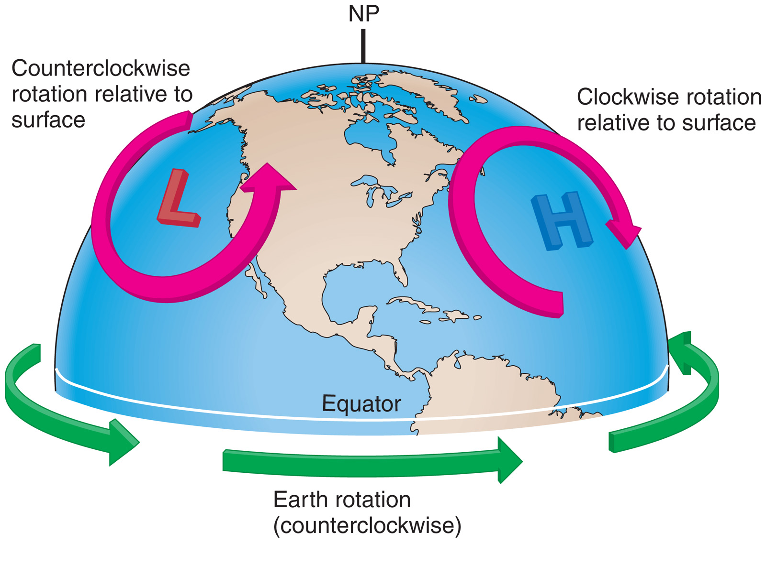
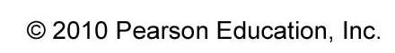
Processes of the Middle and Upper Troposphere
Relative and Earth’s vorticity
negative
positive

Slide 11
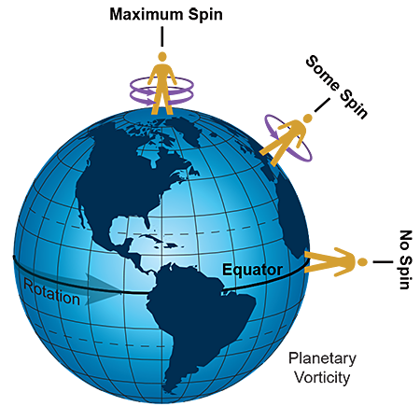
Processes of the Middle and Upper Troposphere
Earth’s vorticity is largest at the pole
It vanishes at the equator
Earth’ vorticity is also called the Coriolis parameter f
f only depends on latitude

Slide 12
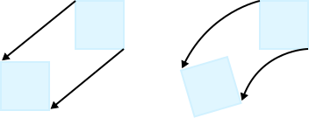
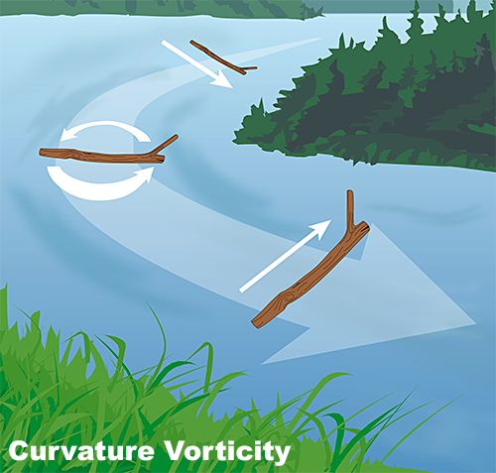
Processes of the Middle and Upper Troposphere
No relative vorticity
Positive relative vorticity
Get’s bigger if more curvature
Absolute vorticity is conserved (constant) because it is closely related to angular momentum.
Absolute vorticity = Earth’s vorticity + relative vorticity = constant
This has important consequences!

Slide 13
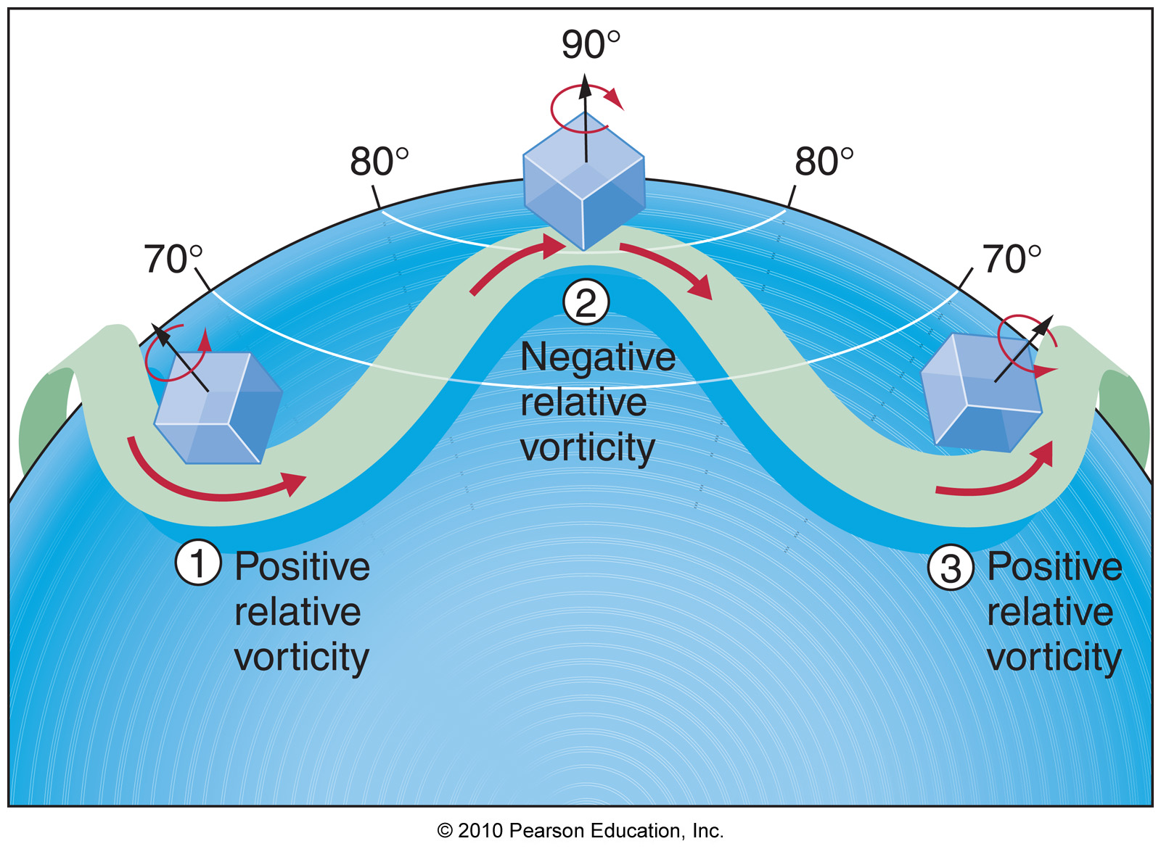
Processes of the Middle and Upper Troposphere
Earth’s vorticity: large
Earth’s vorticity: small
Let’s say an air parcel moves initially in a southeasterly direction
Hence, Earth’s vorticity contribution to the absolute vorticity of the air parcel decreases
BUT, absolute vorticity is a constant. Thus, relative vorticity must increase to compensate -> counterclockwise rotation of air parcel that now moves to the northeast
It “overshoots” its initial latitude and is now at a higher latitude with more Earth’s vorticity.
Still, absolute vorticity is constant. Thus, relative vorticity must decrease and the air parcel rotates clockwise.

Slide 14
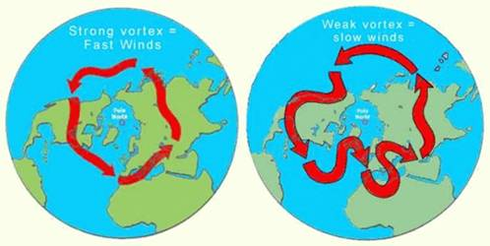
Processes of the Middle and Upper Troposphere
Result is a meandering of the jet stream, which we also identified as Rossby waves.
Rossby waves come from vorticity!
A large incursion into low latitudes is always accompanied
by a large incursion into high latitudes.

Slide 15
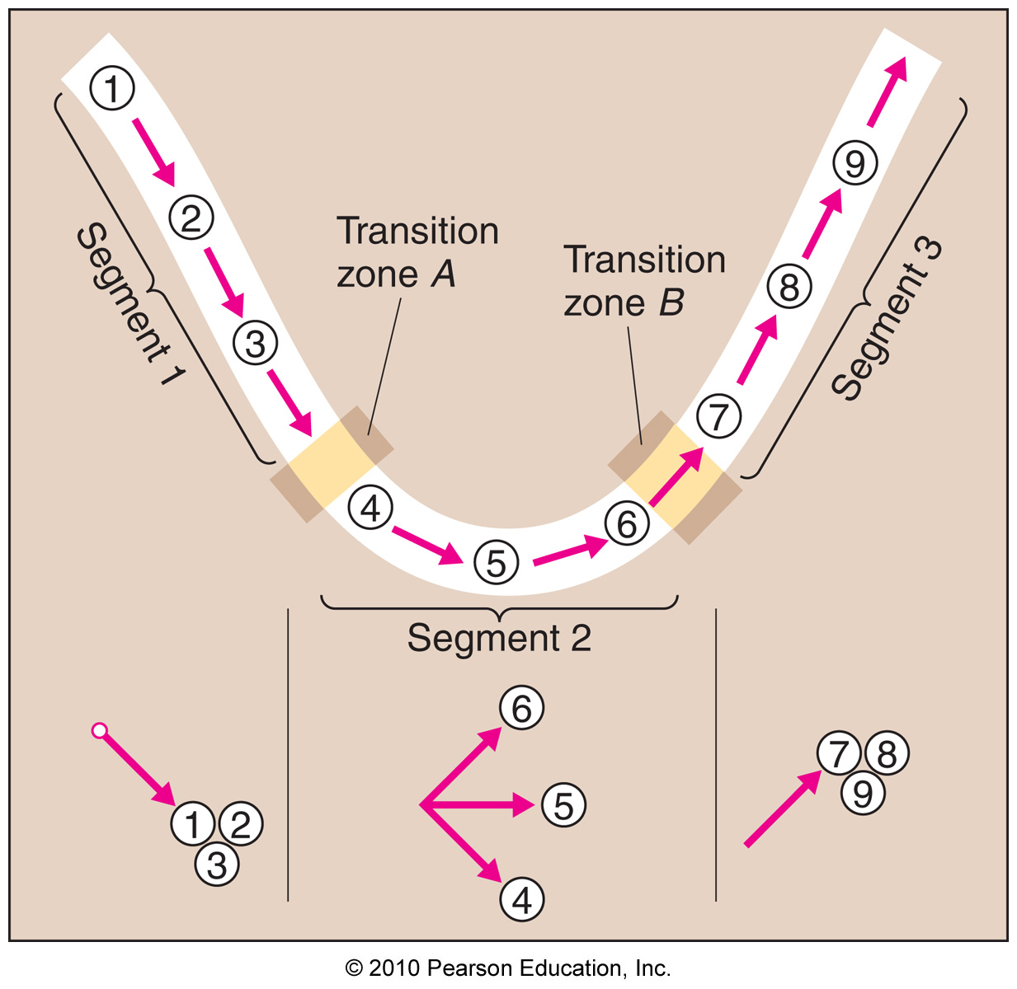
Processes of the Middle and Upper Troposphere
Changing vorticity along a Rossby wave
C
C
Relative vorticity
A: increases (convergence)
B: decreases (divergence)
C: no change
C

Slide 16
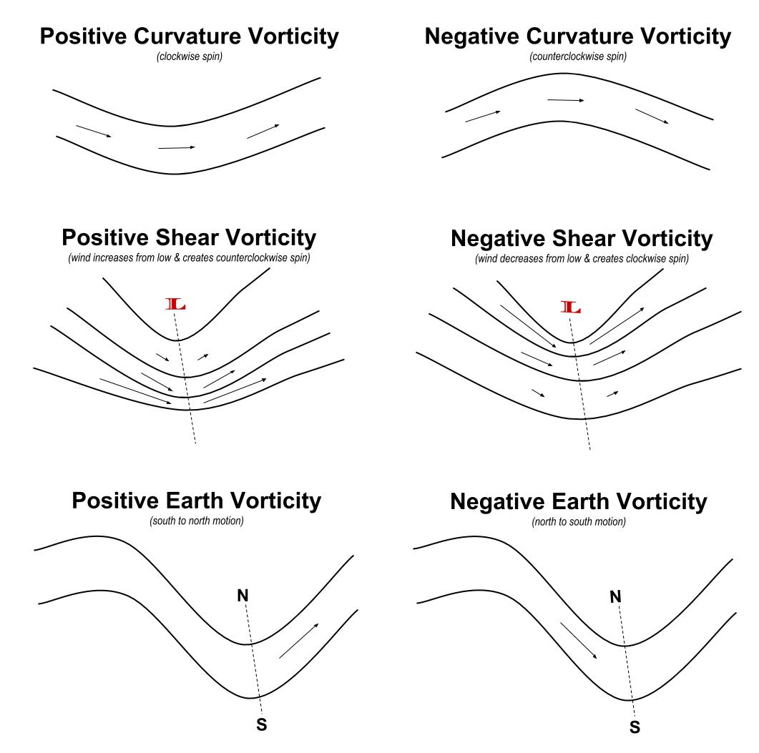
Processes of the Middle and Upper Troposphere
How do I increase a relative vorticity? Or in other words, how do I give it more counter-clockwise spin?
-> Narrow the jet, shear vorticity
-> This only works if winds convergence
convergence
How do I decrease a relative vorticity? Or in other words, how do I give it more clockwise spin?
-> Widen the jet, shear vorticity
-> This only works if winds diverge
divergence

Slide 17
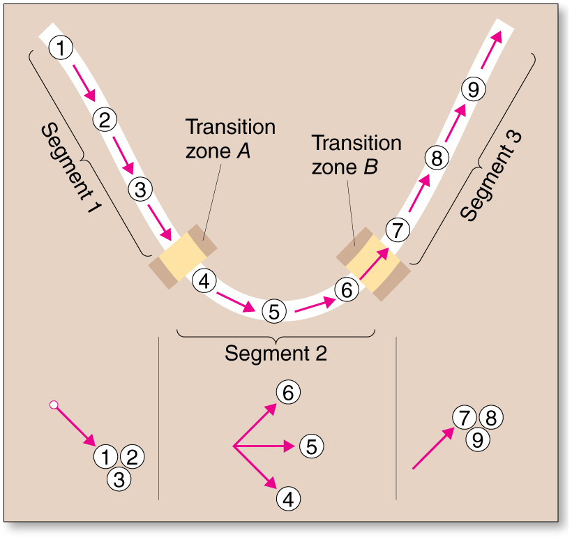
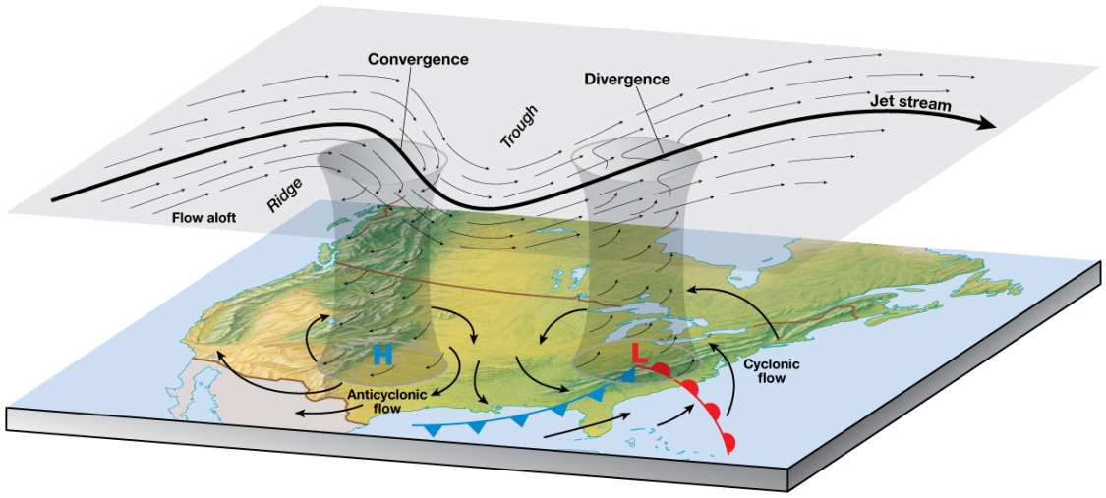
Processes of the Middle and Upper Troposphere
Rossby Waves and Vorticity
Converging and diverging winds
In the middle between ridges and troughs

Slide 18
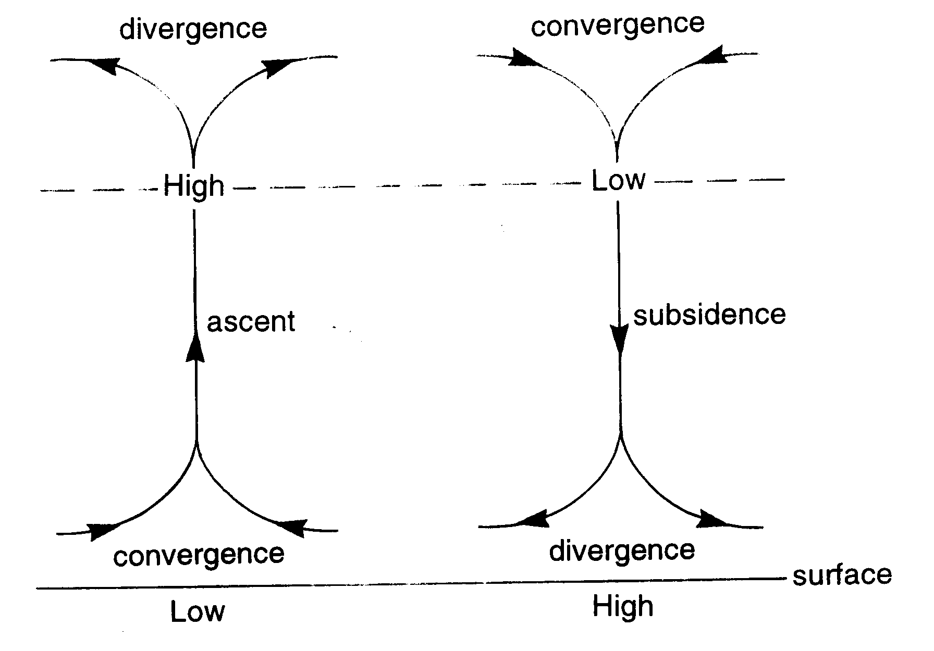
Processes of the Middle and Upper Troposphere

Slide 19
Processes of the Middle and Upper Troposphere
Rossby Waves and Vorticity
In relation to the upper air, maximum and minimum vorticity occurs in relation to troughs and ridges.
Vorticity changes in the upper atmosphere lead to surface pressure changes.
Decreasing vorticity in the zone between a trough and ridge leads to upper air convergence and sinking motions through the atmosphere, which supports surface high pressure areas.
Increasing vorticity in the zone between a ridge and trough leads to upper air divergence and rising motions through the atmosphere, which supports surface low pressure areas.

Slide 20
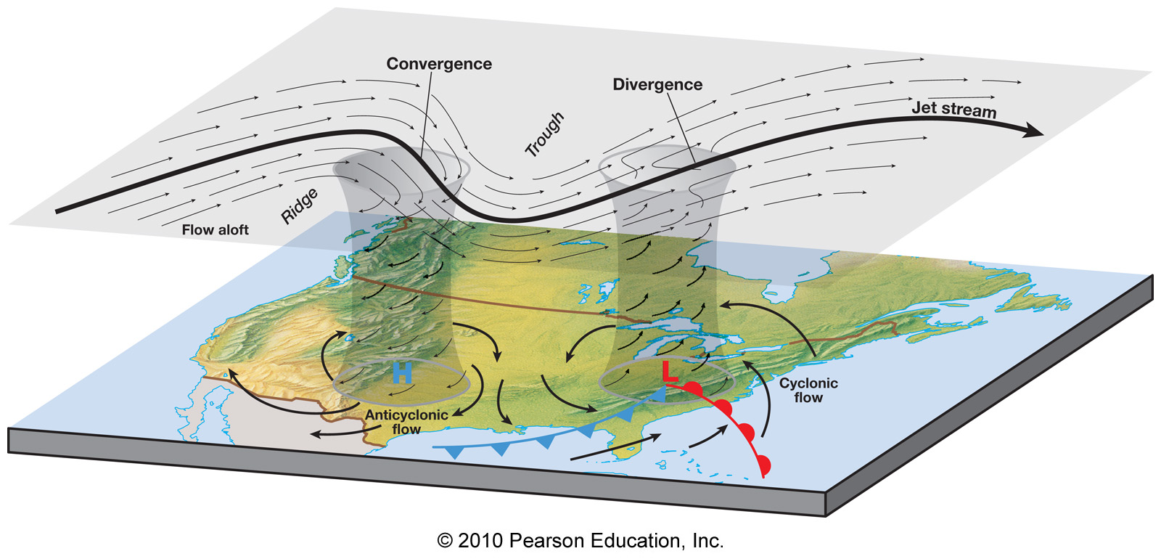
Processes of the Middle and Upper Troposphere
Convergence and divergence along a Rossby wave
Jet stream distortions create dynamic highs and lows at the surface
about in the middle between troughs and ridges
Formation and intensification of midlatitude cyclones!
Upper troposphere is instrumental to this!

Slide 21
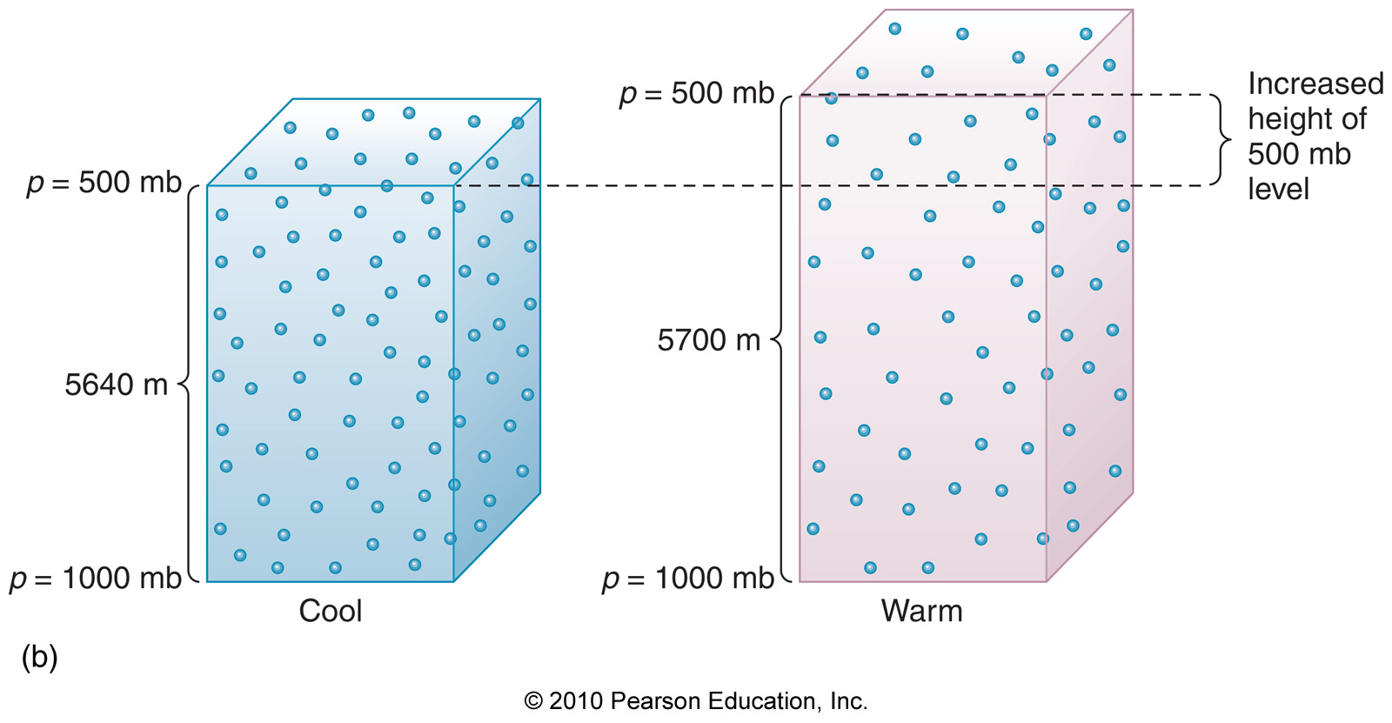
Surface Fronts and Upper-Level Patterns
What about the other way around?
Can cold and warm fronts form upper-level troughs and ridges?
They would thus cause a meandering of the jet stream (Rossby waves)
and then feedback into midlatitude cyclone formation through the vorticity mechanism we just discussed.
From Module 4:
Cool (warm) air has the larger (smaller) vertical pressure gradient

Slide 22
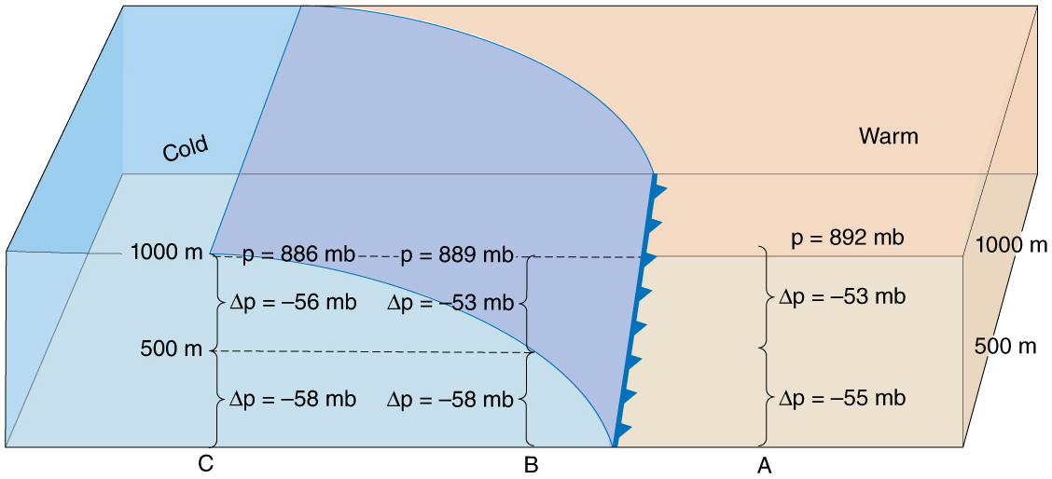
Surface Fronts and Upper-Level Patterns
Cold Fronts and the Formation of Upper-Level Troughs
Low pressure in upper atmosphere behind cold front!
High pressure in upper atmosphere in front of cold front!

Slide 23
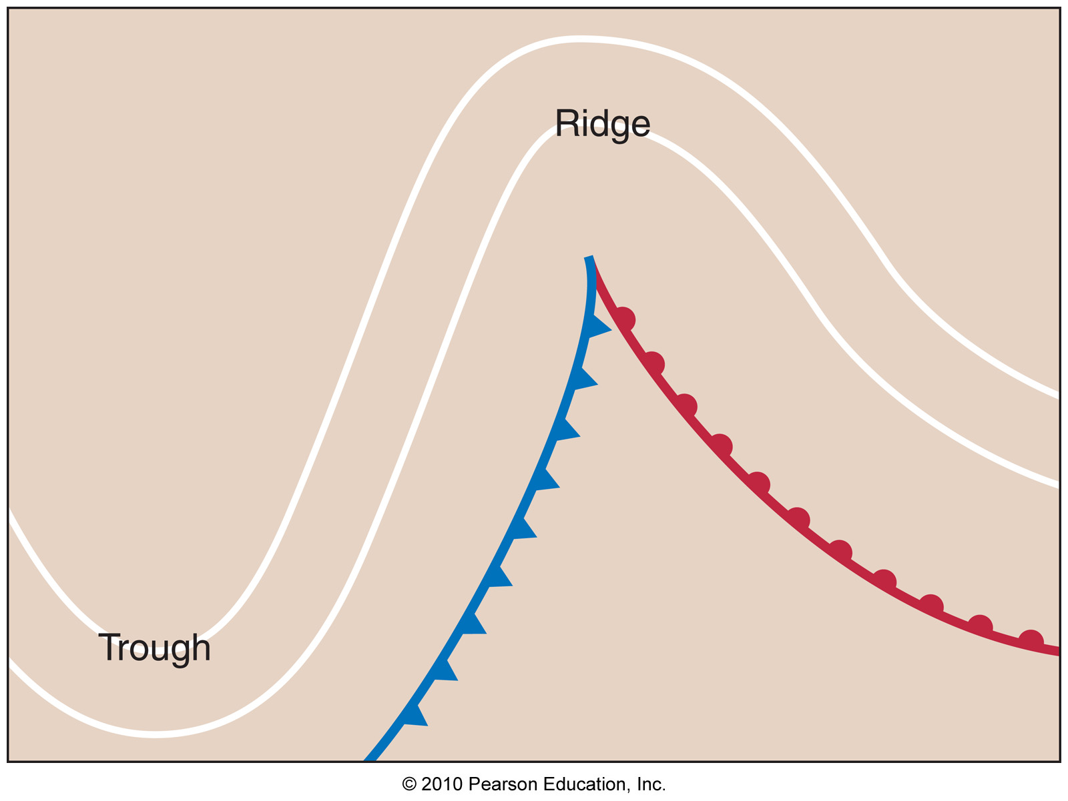
Surface Fronts and Upper-Level Patterns
Cold Fronts and the Formation of Upper-Level Troughs
H
L

Slide 24
Surface Fronts and Upper-Level Patterns
Interaction of Surface and Upper-Level Patterns
The upper atmosphere and the surface are inherently connected and linked. They are not separate.
Divergence and convergence relate to surface pressure differences in cyclones and anticyclones.
Surface temperatures influence vertical pressures and upper atmospheric winds.
Upper level flow patterns explain why midlatitude cyclones exist in addition to aspects of their life cycles.

Slide 25
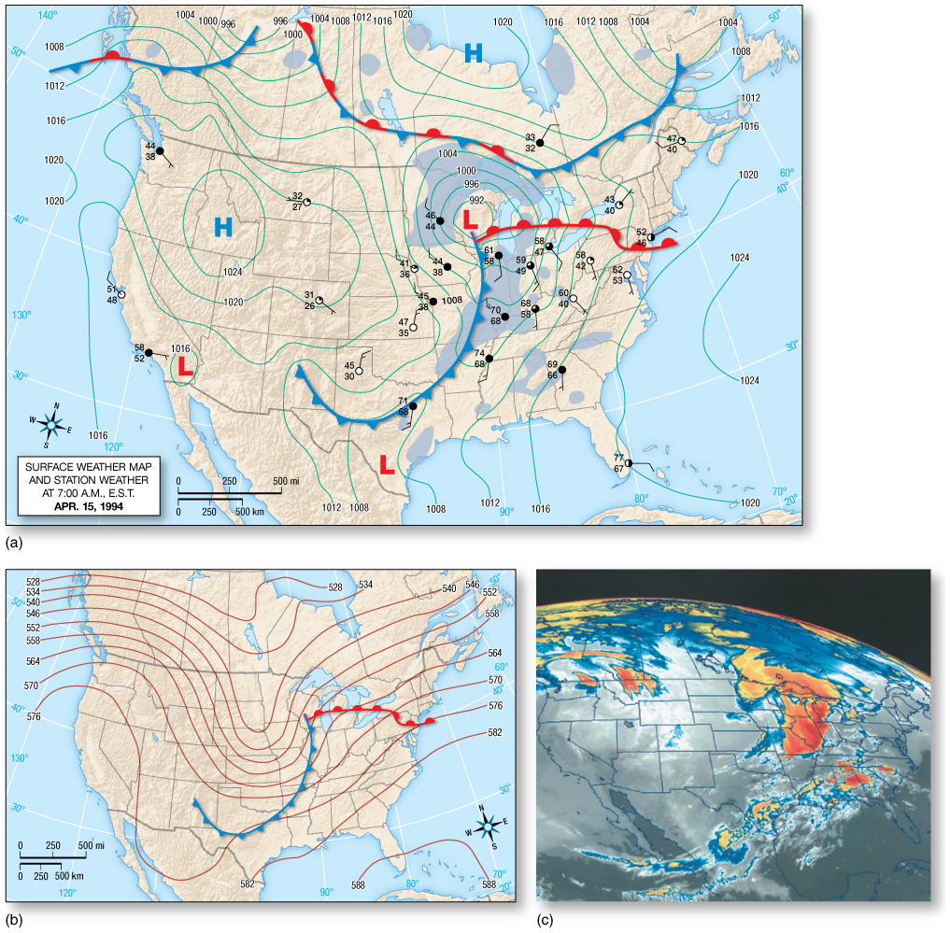
An Example of a Midlatitude Cyclone
April 15
A midlatitude cyclone is centered over the upper midwestern United States.
Heavy rains, high winds, and overcast skies dominate the regions near the central low pressure center.
Recording of wind trajectories at stations throughout the central United States depicts the counterclockwise rotation of the system.
The 500 mb chart shows the storm upstream of the trough axis in the region of decreasing vorticity and upper-level divergence.

Slide 26
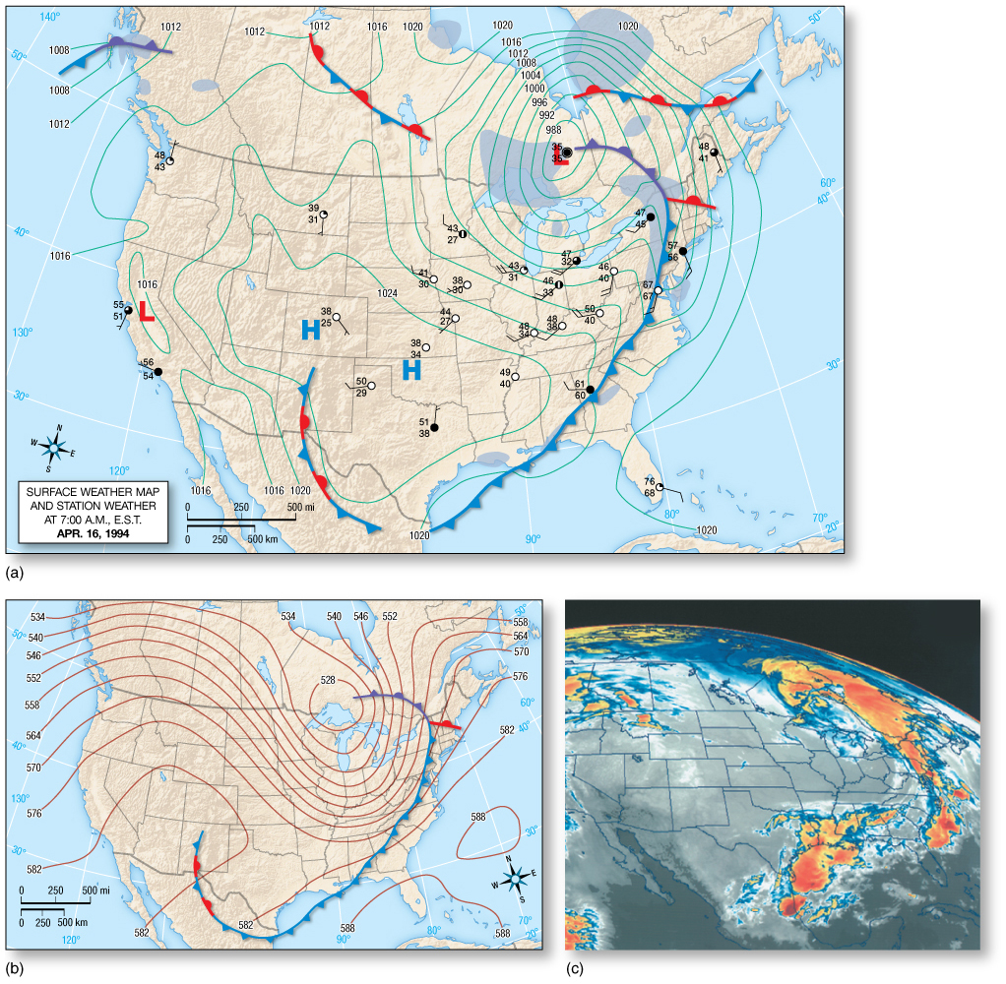
An Example of a Midlatitude Cyclone
April 16
The northeasterly movement of the storm system is seen through a comparison of weather maps over a 24-hour period.
Occlusion occurs as the low migrates over the northern Great Lakes.
In the upper air, the trough has increased in amplitude and strength and become oriented northwest to southeast.
Isobars have closed about the low, initiating a cutoff low.

Slide 27
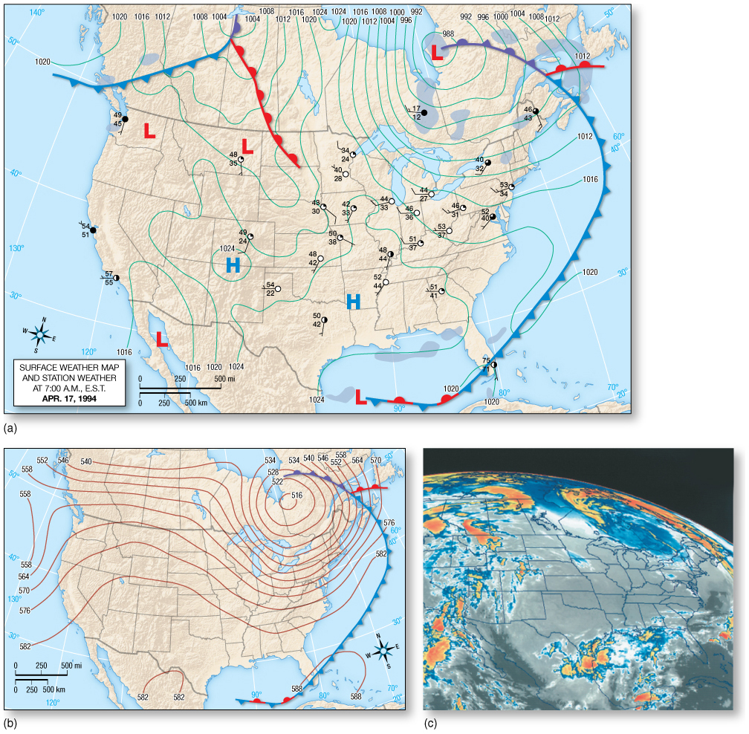
An Example of a Midlatitude Cyclone
April 17
Continual movement towards the northeast is apparent, although system movement has lessened.
The occlusion is now moving northeast of the low, bringing snowfall to regions to the east.
In the upper air, continued deepening is occurring in association with the more robust cutoff low.

Slide 28
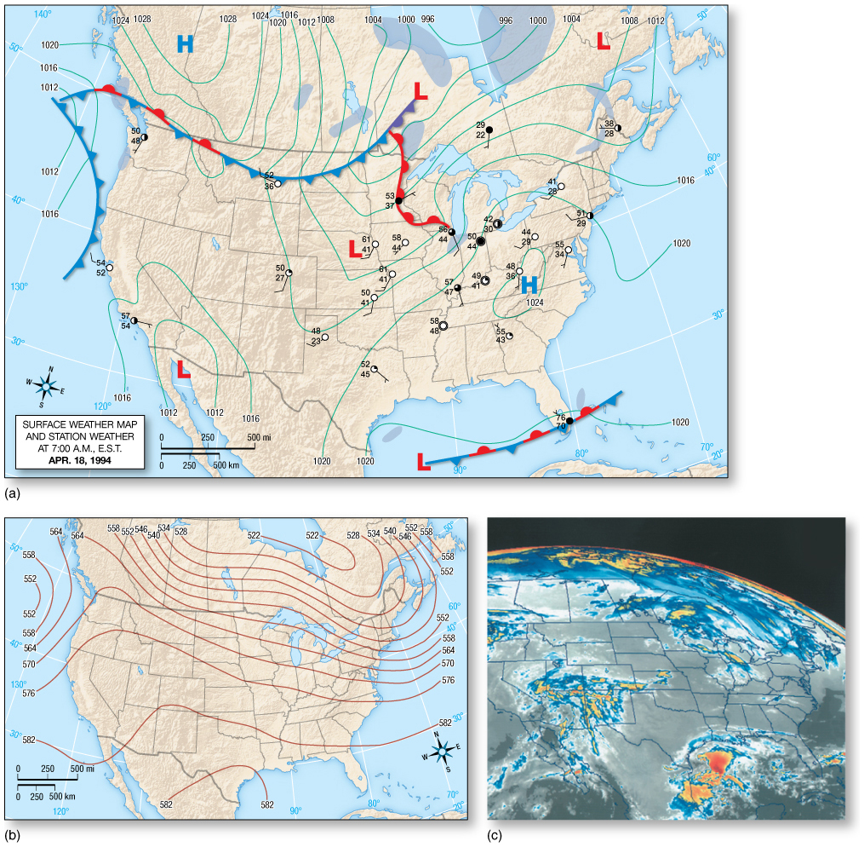
An Example of a Midlatitude Cyclone
April 18
The system has moved over the northwestern Atlantic Ocean, but evidence persists on the continent in the form of widespread precipitation.
The upper atmosphere also shows evidence of the system, with an elongated trough pattern.

Slide 29
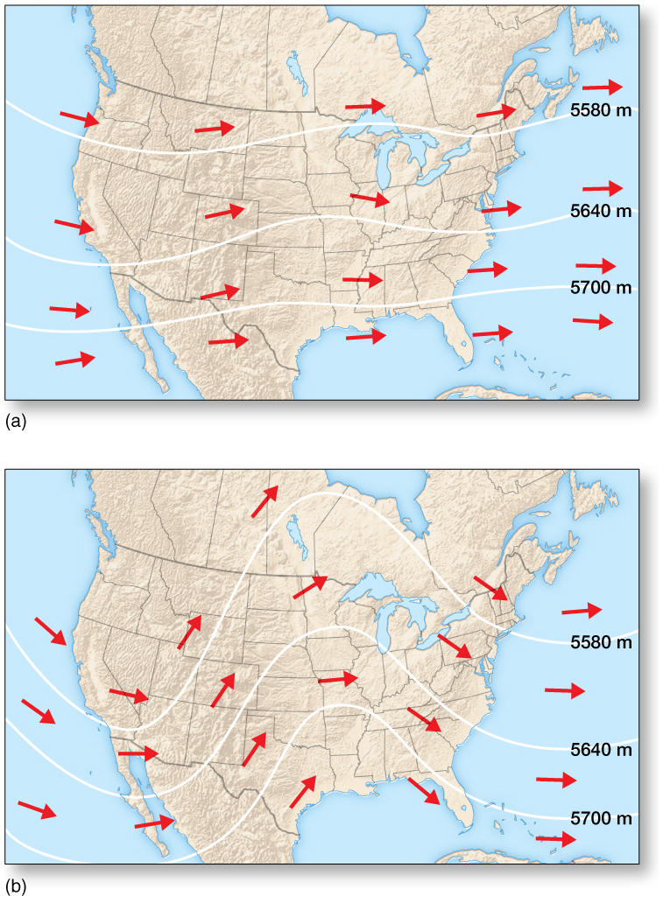
Flow Patterns and Large-Scale Weather
Zonal height patterns prevent development of intense cyclones and anticyclones.
Zonal conditions are usually mild atmospheric conditions at the surface, with small, scattered disturbances.
Meridional conditions actively support cyclone development as vorticity changes between troughs and ridges.
Large-scale flow conditions in the upper atmosphere may persevere for long periods, locking in particular weather situations to affected regions.

Slide 30
Flow Patterns and Large-Scale Weather
The Steering of Midlatitude Cyclones
The movement of surface systems can be predicted by the 500mb pattern, as they move in about the same direction as the 500mb flow, at about 1/2 the speed. Attention: one still needs to predict the 500mb pattern as they are not stationary
Upper-level winds are about twice as strong in winter than summer.
Winter midlatitude cyclones may be grouped by common paths across North America.
Alberta Clippers are associated with zonal flow and usually produce light precipitation.
Colorado lows are usually stronger storms which produce more precipitation.
East Coast storms typically have strong uplift and high water vapor content.

Slide 31
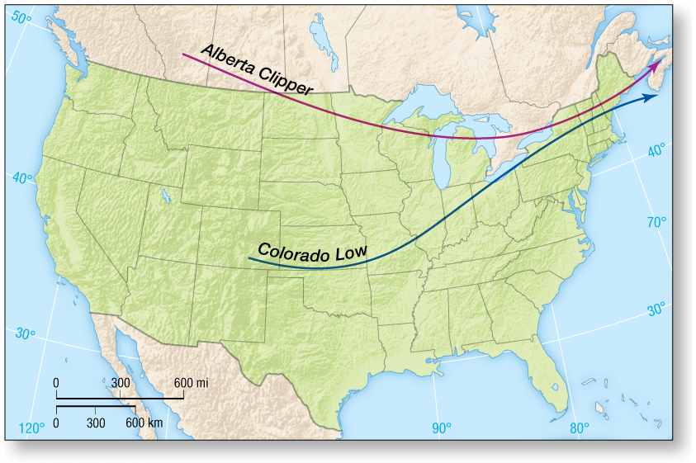
Flow Patterns and Large-Scale Weather
The Steering of Midlatitude Cyclones

Slide 32
Flow Patterns and Large-Scale Weather
Migration of Surface Cyclones Relative to Rossby Waves
Upper-air divergence must be present for a midlatitude cyclone to form.
If divergence aloft exceeds surface convergence, the surface low will strengthen and a cyclone forms. If convergence at the surface exceeds divergence aloft, the low weakens.
Surface cyclones generally move in the same direction as the 500mb winds and at about 1/2 the speed.
The surface low generally moves southwest to northeast relative to the Rossby wave configuration. It moves away from the region of maximum divergence aloft, eventually dissipating as it approaches the upper-level ridge.

Slide 33
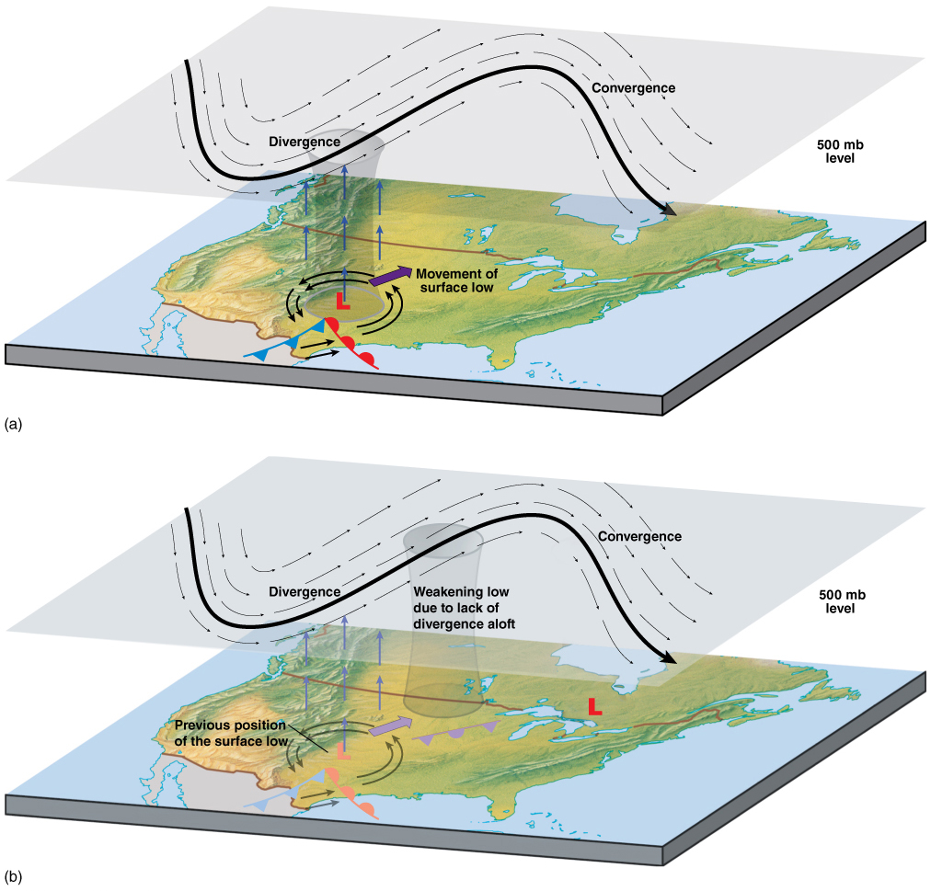
Flow Patterns and Large-Scale Weather
Migration of Surface Cyclones Relative to Rossby Waves

Slide 34
The Modern View: Midlatitude Cyclones and Conveyor Belts
The conveyor belt model helps describe conditions associated with midlatitude cyclones through a three-dimensional perspective.
The model uses three major flows:
Warm conveyor belt
Cold conveyor belt
Dry conveyor belt

Slide 35
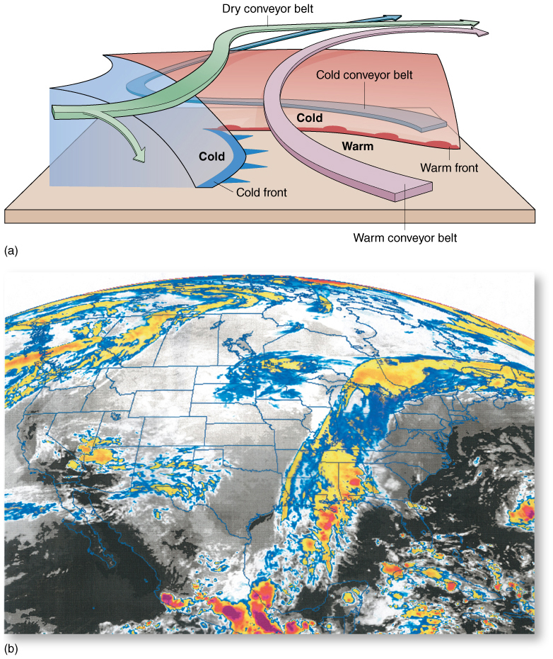
The Modern View: Midlatitude Cyclones and Conveyor Belts

Slide 36
The Modern View: Midlatitude Cyclones and Conveyor Belts
The warm conveyor belt originates near the surface in the warm sector and flows toward the warm front.
Air flowing toward the storm center is displaced aloft until it overrides the warm front where it turns to the right, becoming part of the westerly flow aloft.
The cold conveyor belt lies north of the warm front.
It travels westward near the surface, where it ascends and turns clockwise to become part of the westerly upper air flow.
The dry conveyor belt originates in the upper troposphere as part of the westerly flow.
Air sinks into the trough only to rise over the region of the surface low before continuing east.
Integral to maintaining separate cloud bands which give the system its characteristic comma shape.

Slide 37
Anticyclones
Anticyclones are associated with clear skies and calm conditions.
If anticyclones linger over a region, it can lead to droughts.
Anticyclones are responsible for the Santa Ana wind conditions over the west coast, United States.

Slide 38
Climate Change and Midlatitude Cyclones
Midlatitude cyclones are associated with the polar front and polar jet stream.
It’s important to consider if climate change will cause a shift in the average tracks of midlatitude cyclones.
Recent studies have shown that the average tracks for midlatitude cyclones have shifted toward the poles.
The IPCC believes that continued warming and climate change will continue to move the tracks of the midlatitude cyclones toward the poles. This will have serious climate consequences to the Earth.

Slide 39
Attendance Quiz
Please go to Canvas and do the attendance quiz!
Needs to be completed between 9 am and 5 pm on April 14. Usual 3 min time limit.
Password: cyc

Slide 40
Summary and Key Points
Distortions of polar front initiate mid-latitude cyclones (cyclogenesis)
Upper troposphere ridges and troughs caused by Rossby waves produce high and low pressure systems at the surface b/c of divergence and convergence – a consequence of vorticity
Instrumental in formation and intensification of mid-latitude cyclones
Cold and warm fronts produce ridges and troughs; complex interplay
Steering of mid-latitude cyclones

